Slide 1
CST462s: Research Methods
Definition, Process, and Relevant Methods

Slide 2

Today’s Topics
Definition of research
Types of research
Research questions
Significance of research
Research Process
Data collection

Slide 3
Research is a process used to collect and analyze information to increase our understanding of a topic or an issue.
Re: Again
Search: Find
It consists of three steps:
1) Pose a research question
2) Collect data to answer the question
3) Present an answer to the question

Slide 4

Applied Research
Applied research is designed to solve practical problem of the modern world.
The goal is to improve the human condition.
It focuses on analysis and solving social and real life problems.
Eg.: increase corn production, improve home energy efficiency, decrease inequality in housing market, increase number of girls in STEM fields, …
Applied research can be further classified, a relevant category:
Problem oriented research: sorting out problems to reach a conclusive finding to identify what is the exact problem

Slide 5
Qualitative Research: is used for collecting, analyzing, and interpreting data by observing what people do and say. It is much more subjective and uses different data collection methods. The nature of this type of research is exploratory and open ended.
For example:
1) Phenomenology
2) Ethnography
3) Case study

Slide 6

Phenomenology
Focuses on the commonality of a lived experience within a particular group.
The fundamental goal of the approach is to arrive at a description of the nature of the particular phenomenon (Creswell, 2013).
Typically, interviews are conducted with a group of individuals who have first-hand knowledge of the situation or experience.
Other forms of data such as documents, observations and art may also be used.
With roots in philosophy, psychology and education, phenomenology attempts to extract the most pure, untainted data.

Slide 7
Bracketing: The researcher sets aside their experiences, biases, and preconceived notions to understand the phenomenon appears to the participants not how it is perceived by the researchers.
Recruit participants who have had lived experience with the concept or phenomenon being researched.
Researcher develops clusters of meanings into themes.
Write the essence of the phenomenon.

Slide 8
Sample Research Questions
You are concerned whether today’s rapid evolution of information and communication technologies lessen the digital divide or contribute to its growth in America.
Will addressing resource inequalities (such as providing a computer that can get online) help decrease digital divide?
How do teachers and parents perceive about use of social network services to encourage connected learning culture in K-12 contexts? Are there any benefits of doing so? Do people with different social status have different perceptions?
What are the burning issues of older adults when it comes to technology use and online resource access?
What factors beyond coincidence or economics explain why digital divide exists?
Are there any other questions that could be part of your research project?
Notes:
https://www.youtube.com/watch?v=iL7Ww5kpnIM
https://www.youtube.com/watch?v=vOsE9saR_ck

Slide 9

Other perception level questions
What have you experienced in terms of the phenomenon?
What contexts or situation have typically influenced your experiences of the phenomenon?
What is the lived experience of the phenomenon (e.g. digital divide) and how has this affected their perceptions of self?
Notes:
https://www.youtube.com/watch?v=iL7Ww5kpnIM
https://www.youtube.com/watch?v=vOsE9saR_ck
https://www.slideshare.net/86500/ppt-on-research-in-management-unit-i
https://www.google.com/search?rlz=1C1GGRV_enUS751US751&ei=bLaTXefVC7Ho9APHk5LAAw&q=racial+discrimination+phenomenology+research+questions&oq=racial+discrimination+phenomenology+research+questions&gs_l=psy-ab.3...6806.11509..12071...1.2..0.86.1658.23......0....1..gws-wiz.......0i71j0i13j0i13i5i30j0i8i13i30j33i10.7QSnXecJw1M&ved=0ahUKEwjnu7HS8vvkAhUxNH0KHceJBDgQ4dUDCAs&uact=5

Slide 10
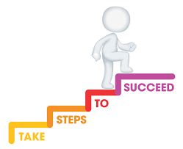
Steps of conducting research
Get background information and formulate your questions
Do literature review and refine your research questions
Select appropriate data collection methods
Analyze your data
Summarize your findings and conclude
Compose your references along the way

Slide 11
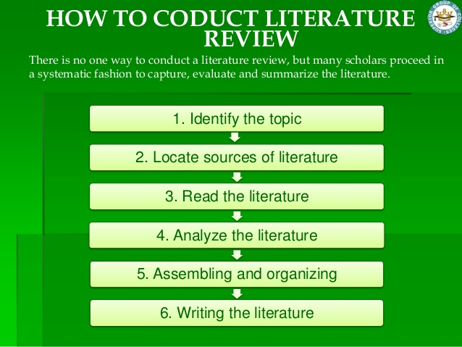
Literature Review
Choose a topic and define your research questions;
Decide on a scope of your review;
Search relevant policies and publications. Keep track of your searches!
Skim through the abstracts to decide whether you should read the paper carefully;
Review the literature and keep notes so that you could track your thought processes better;

Slide 12

Observation
Observation research is the systematic process of recording the behavioral patterns of people, objects, and occurrences as they are witnessed.
Identify objective (decide what you want to observe, develop questions and techniques)
Establish recording method
Observe and take notes
Analyze behaviors and inferences

Slide 13
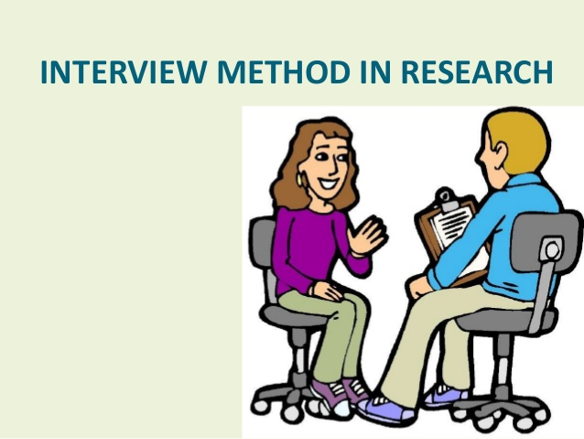
Interview
Structured interview
  Each interviewee gets the same questions, in the same way, in the same order
  Fixed choice questions, no open ended questions
Semi-structured interview
Unstructured (no predetermined questions)
One-on-one interview
Focus group interview

Slide 14
Data Collection
Record interviews if needed
Take notes (a must to have)
Document and organize all notes and raw data
Data Analysis
Skim through your notes
Categorize by interview question
Read through all answer to each question to identify common themes and pattern
Write and summarize your findings

Slide 15

Significance of Research
To gather necessary information
To make changes
To improve standard of living
For a safer life
To know the truth
Explore our history
...

Slide 16

Next Steps
Review Project Specifications
Team planning and collaboration
Next deliverable and timeline
Expectations & peer evaluation

